Slide 1

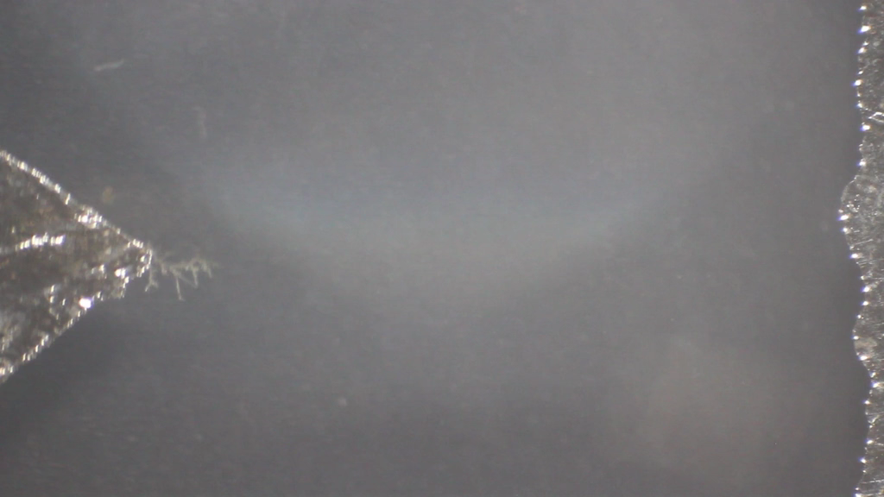
x8
X16
12. Metallic forest
Ivan Kalesnikau
In the electrolysis of aqueous solutions of metal salts, fractal-like dendrites can begin to grow gradually on the electrodes. How can the dendrite shape and fractal dimension be controlled by choice and variation of the setup parameters?

Slide 2
Overview
Introduction
1
Demo, Experimental setup
Qualitative description
2
Euler’s equation
Theoretical & Experimental description
3
Motion phases, Equations derivation
Numerical solution, Convergence with experiment
Conclusions
4
Last remarks

Slide 3
Phenomenon
Parameters
Phenomenon
Salt concentration
Current
Applied voltage
Cathode shape
Why are dendrites formed?
What is fractal dimension?
How do relevant parameters influence shape/rate of growth?
Notes:
Краевое отношение масс

Slide 4
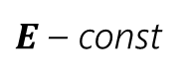
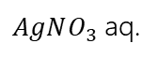
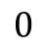
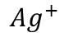
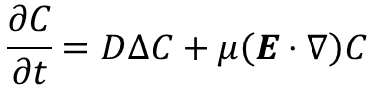
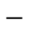
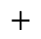
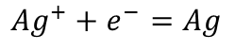
Experimental setup
Mass transport by:
Migration
Diffusion
Deposit
$AgNO_{3}$ aq.
$$Ag^{+}+e^{−}=Ag$$
Silver cathode
$$Ag^{+}$$
Silver anode
!
Assumption
$E$ – const
Surface
reaction
$$\frac{∂C}{∂t}=D∆C+μ\left(E⋅∇\right)C$$
$$0$$
!
Assumption
$$−$$
$$+$$
Rate of deposition << mass transfer rate

Slide 5
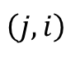
Simulation: stage 1
1
Seed grid with particles
&
Select random one
$$\left(j, i\right)$$

Slide 6
Simulation: stage 2
Seed grid with particles
1
&
Select random one
Randomly move particle according to motion equation
2

Slide 7
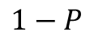
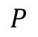
Simulation: stage 3
Seed grid with particles
1
&
Select random one
Randomly move particle according to motion equation
2
3
Collision
$$P$$
$$1−P$$
Deposition
Stage 2
Surface relaxation

Slide 8
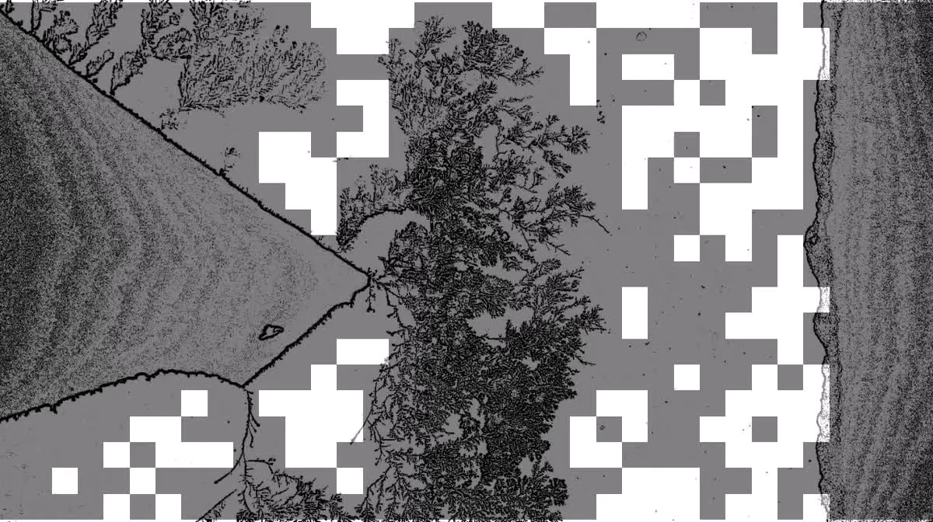
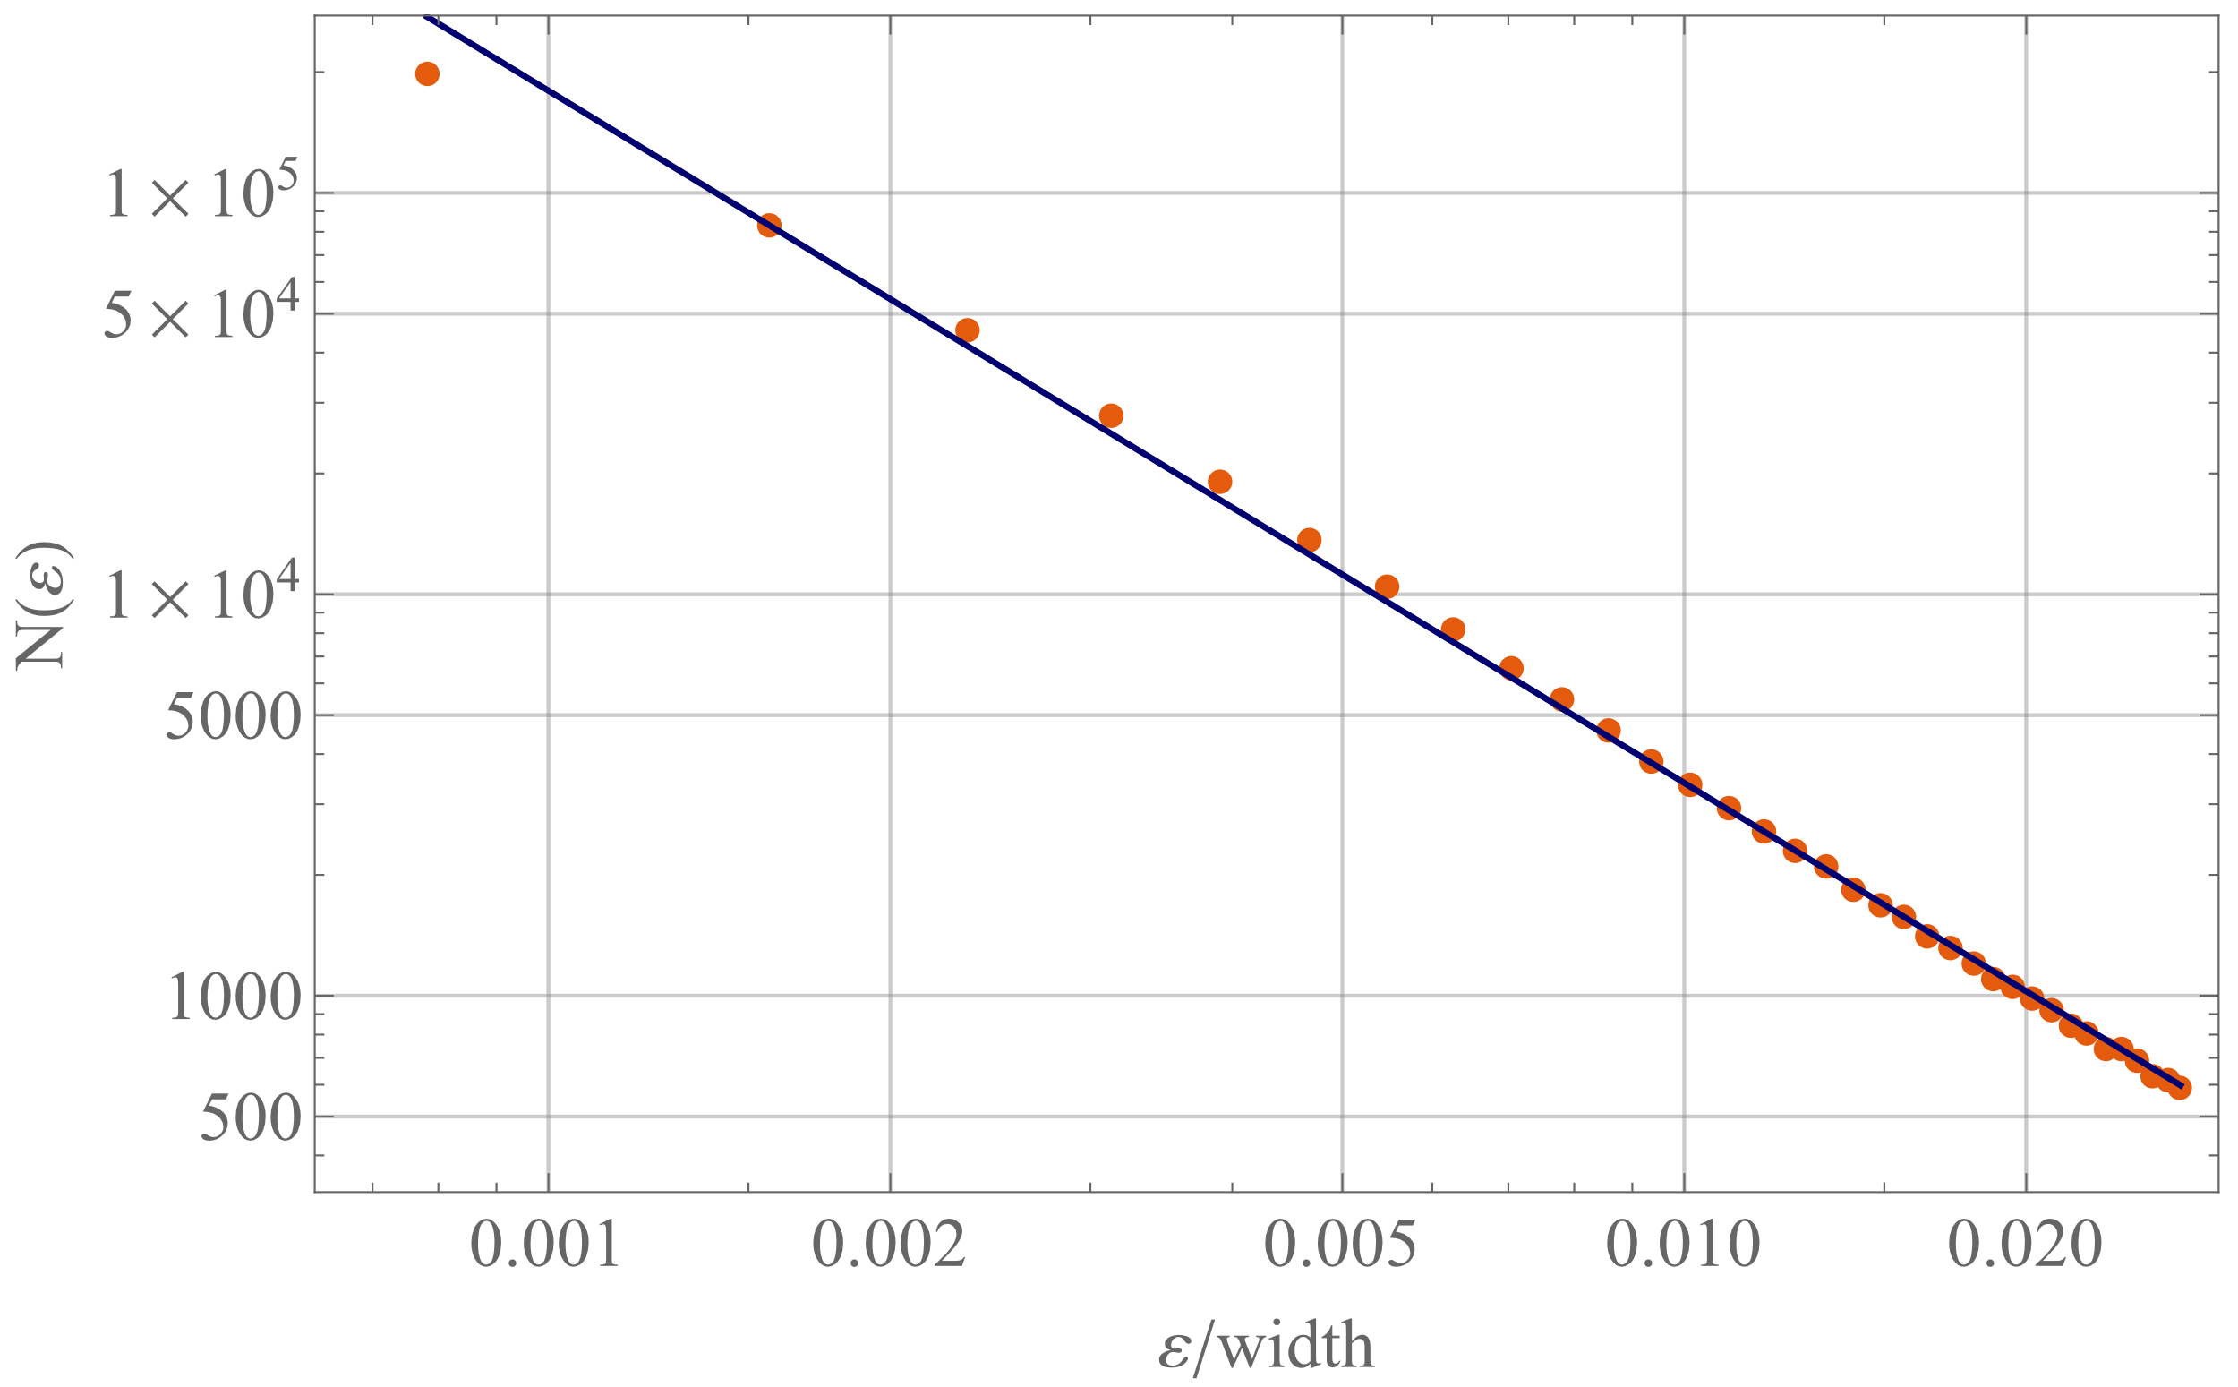
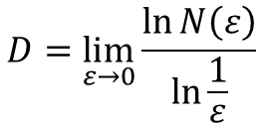
Fractal dimension: box counting
$$D=\lim_{ε→0}{\frac{\ln{N\left(ε\right)}}{\ln{\frac{1}{ε}}}}$$

Slide 9
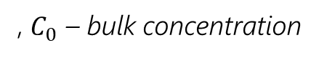
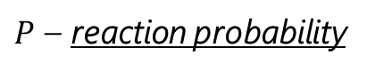
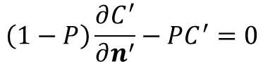
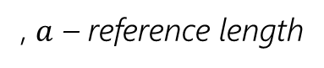
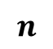
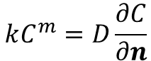
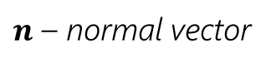
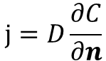
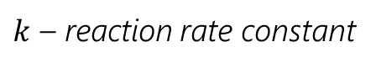
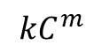
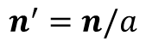
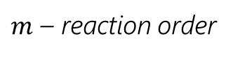
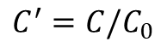

Surface reaction
!
Notation
Production rate
$m$ – reaction order
$$kC^{m}=D\frac{∂C}{∂n}$$
$k$ – reaction rate constant
$$kC^{m}$$
Mass flux
$n$ – normal vector
$$⇒$$
$$n^{′}=n/a$$
, $a$ – reference length
$$j=D\frac{∂C}{∂n}$$
$$C^{′}=C/C_{0}$$
, $C_{0}$ – bulk concentration
$$n$$
$$\left(1−P\right)\frac{∂C^{′}}{∂n^{′}}−PC^{′}=0$$
$P$ – reaction probability

Slide 10
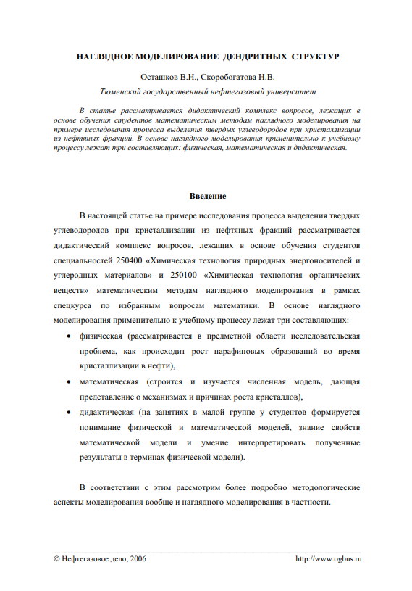
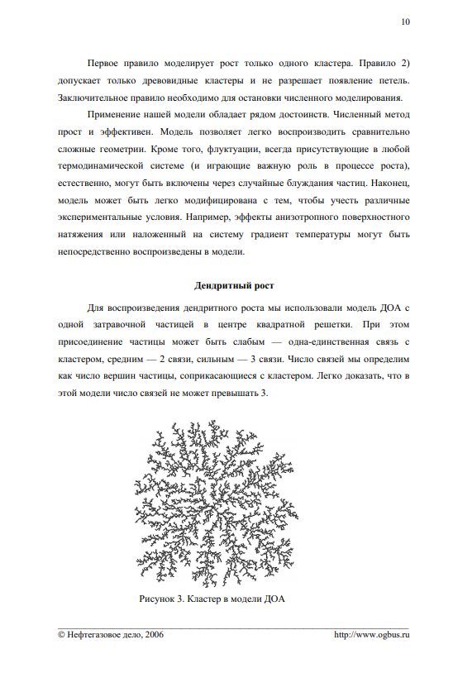
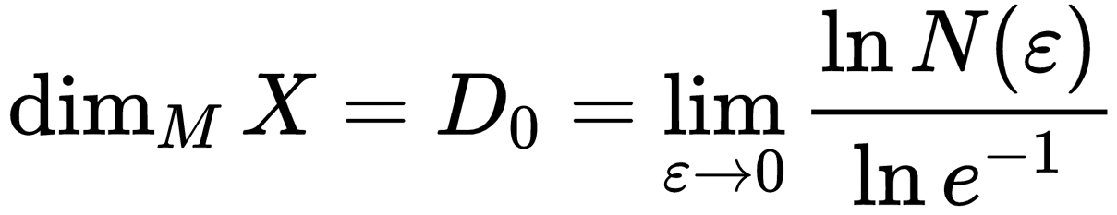

Slide 11
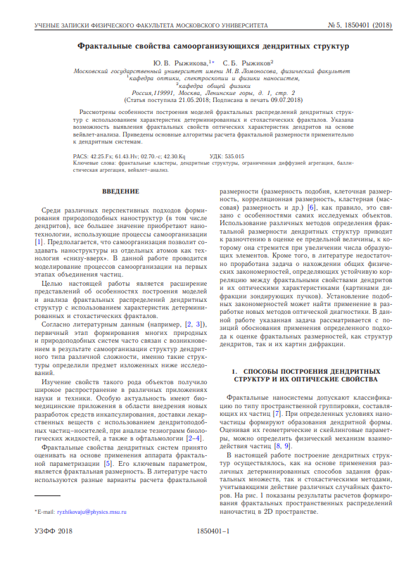
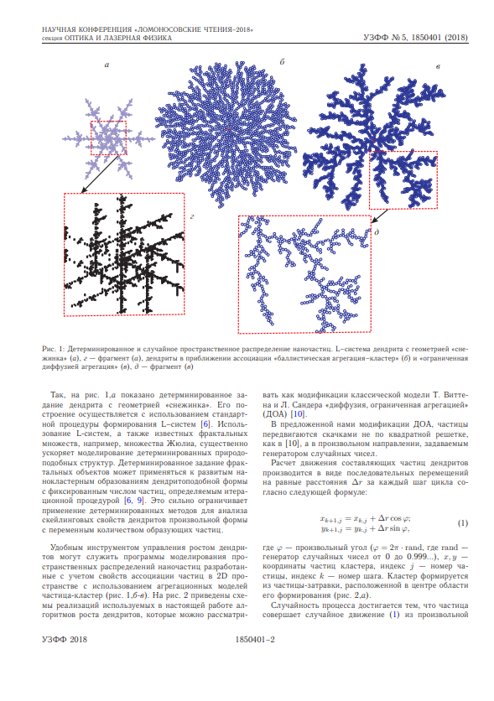
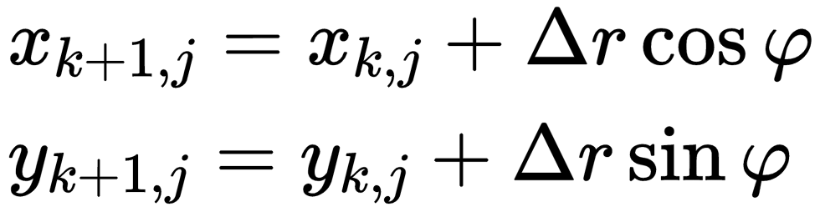

Slide 12
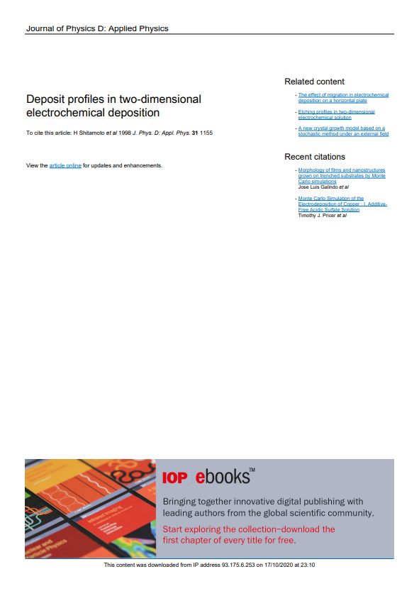
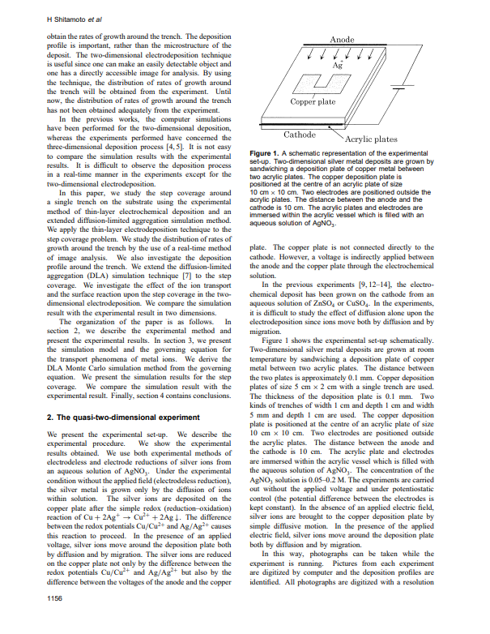
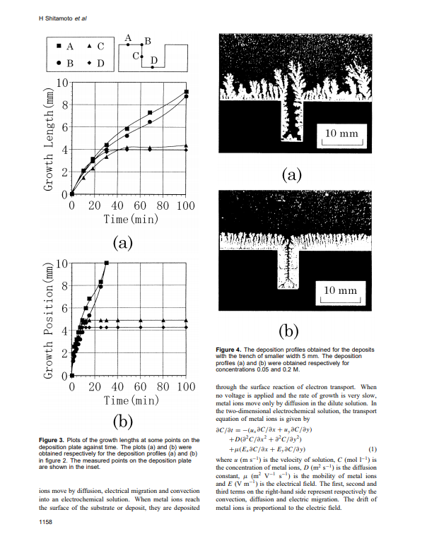

Slide 13
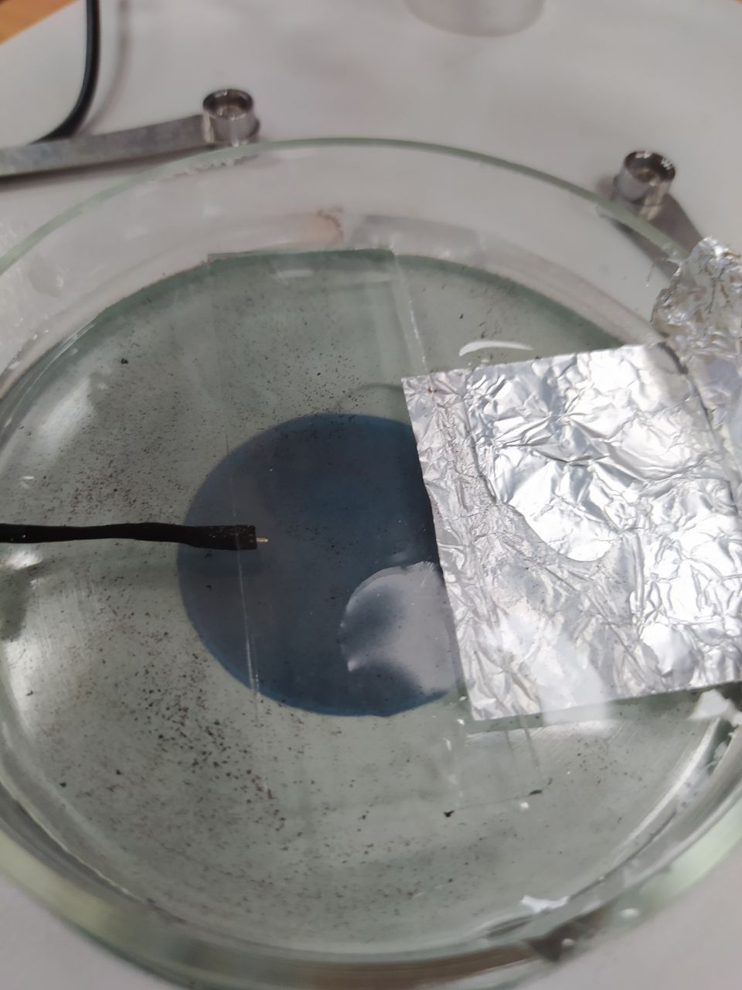
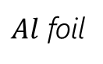
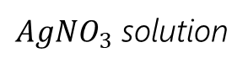
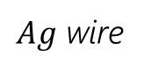
Experimental setup
$AgNO_{3}$ solution
$Ag$ wire
$Al$ foil

Slide 14
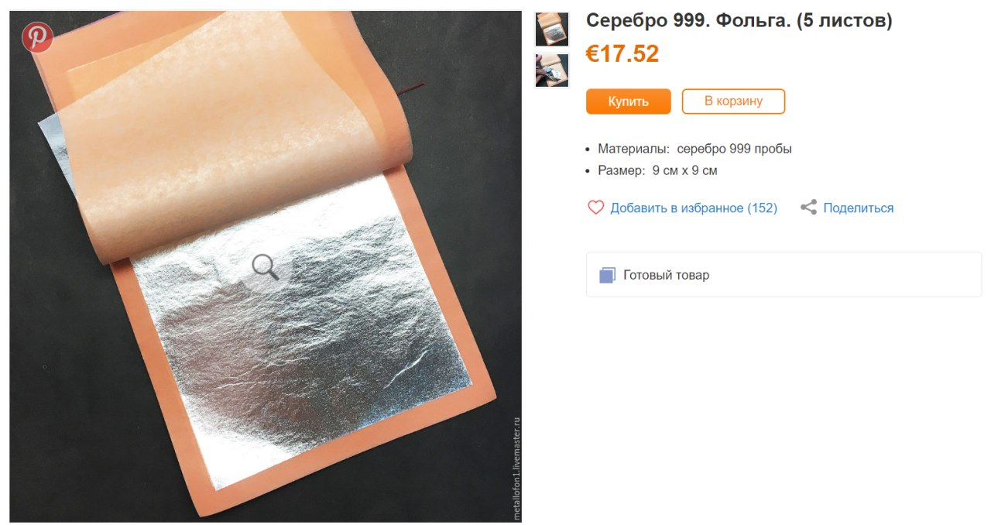
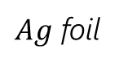
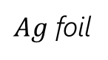
Experimental setup
$AgNO_{3}$ solution
$Ag$ foil
$Ag$ foil

Slide 16
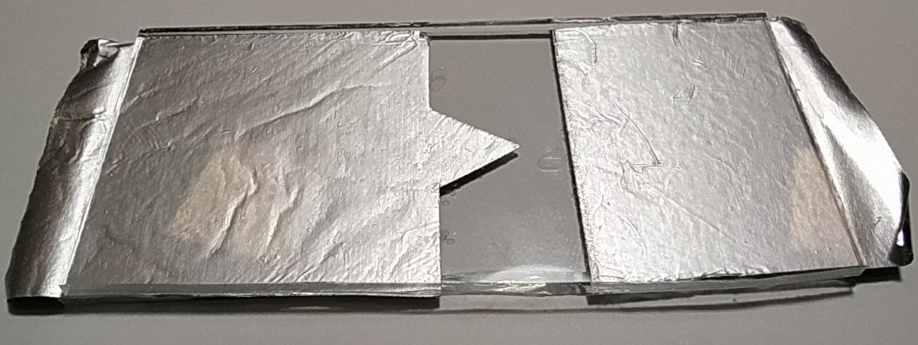
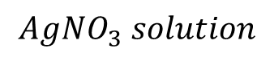
$$AgNO_{3} solution$$
Glass
999 Silver foil

Slide 17
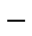
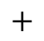
A
V
$$−$$
$$+$$

Slide 18
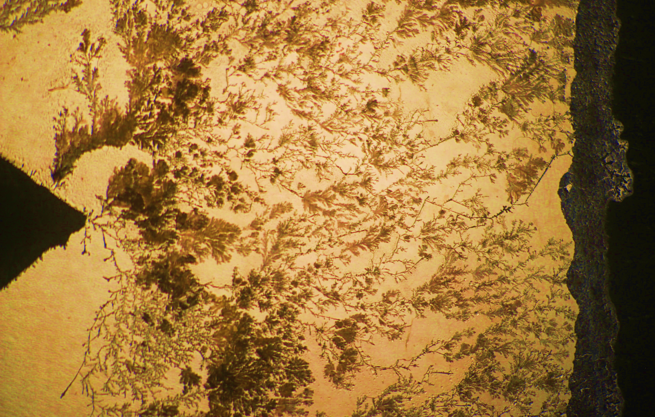
Experimental setup
Camera
Laptop
Slide

Slide 19
References
H Shitamoto et al 1998 J. Phys. D: Appl. Phys. 31 1155
Theoretical background
Simulation reference
Experimental setup idea
Szabolcs Horvát “Measuring the fractal dimension of a tree photo”
https://community.wolfram.com/groups/-/m/t/1025046
Box counting algorithm idea

Slide 20
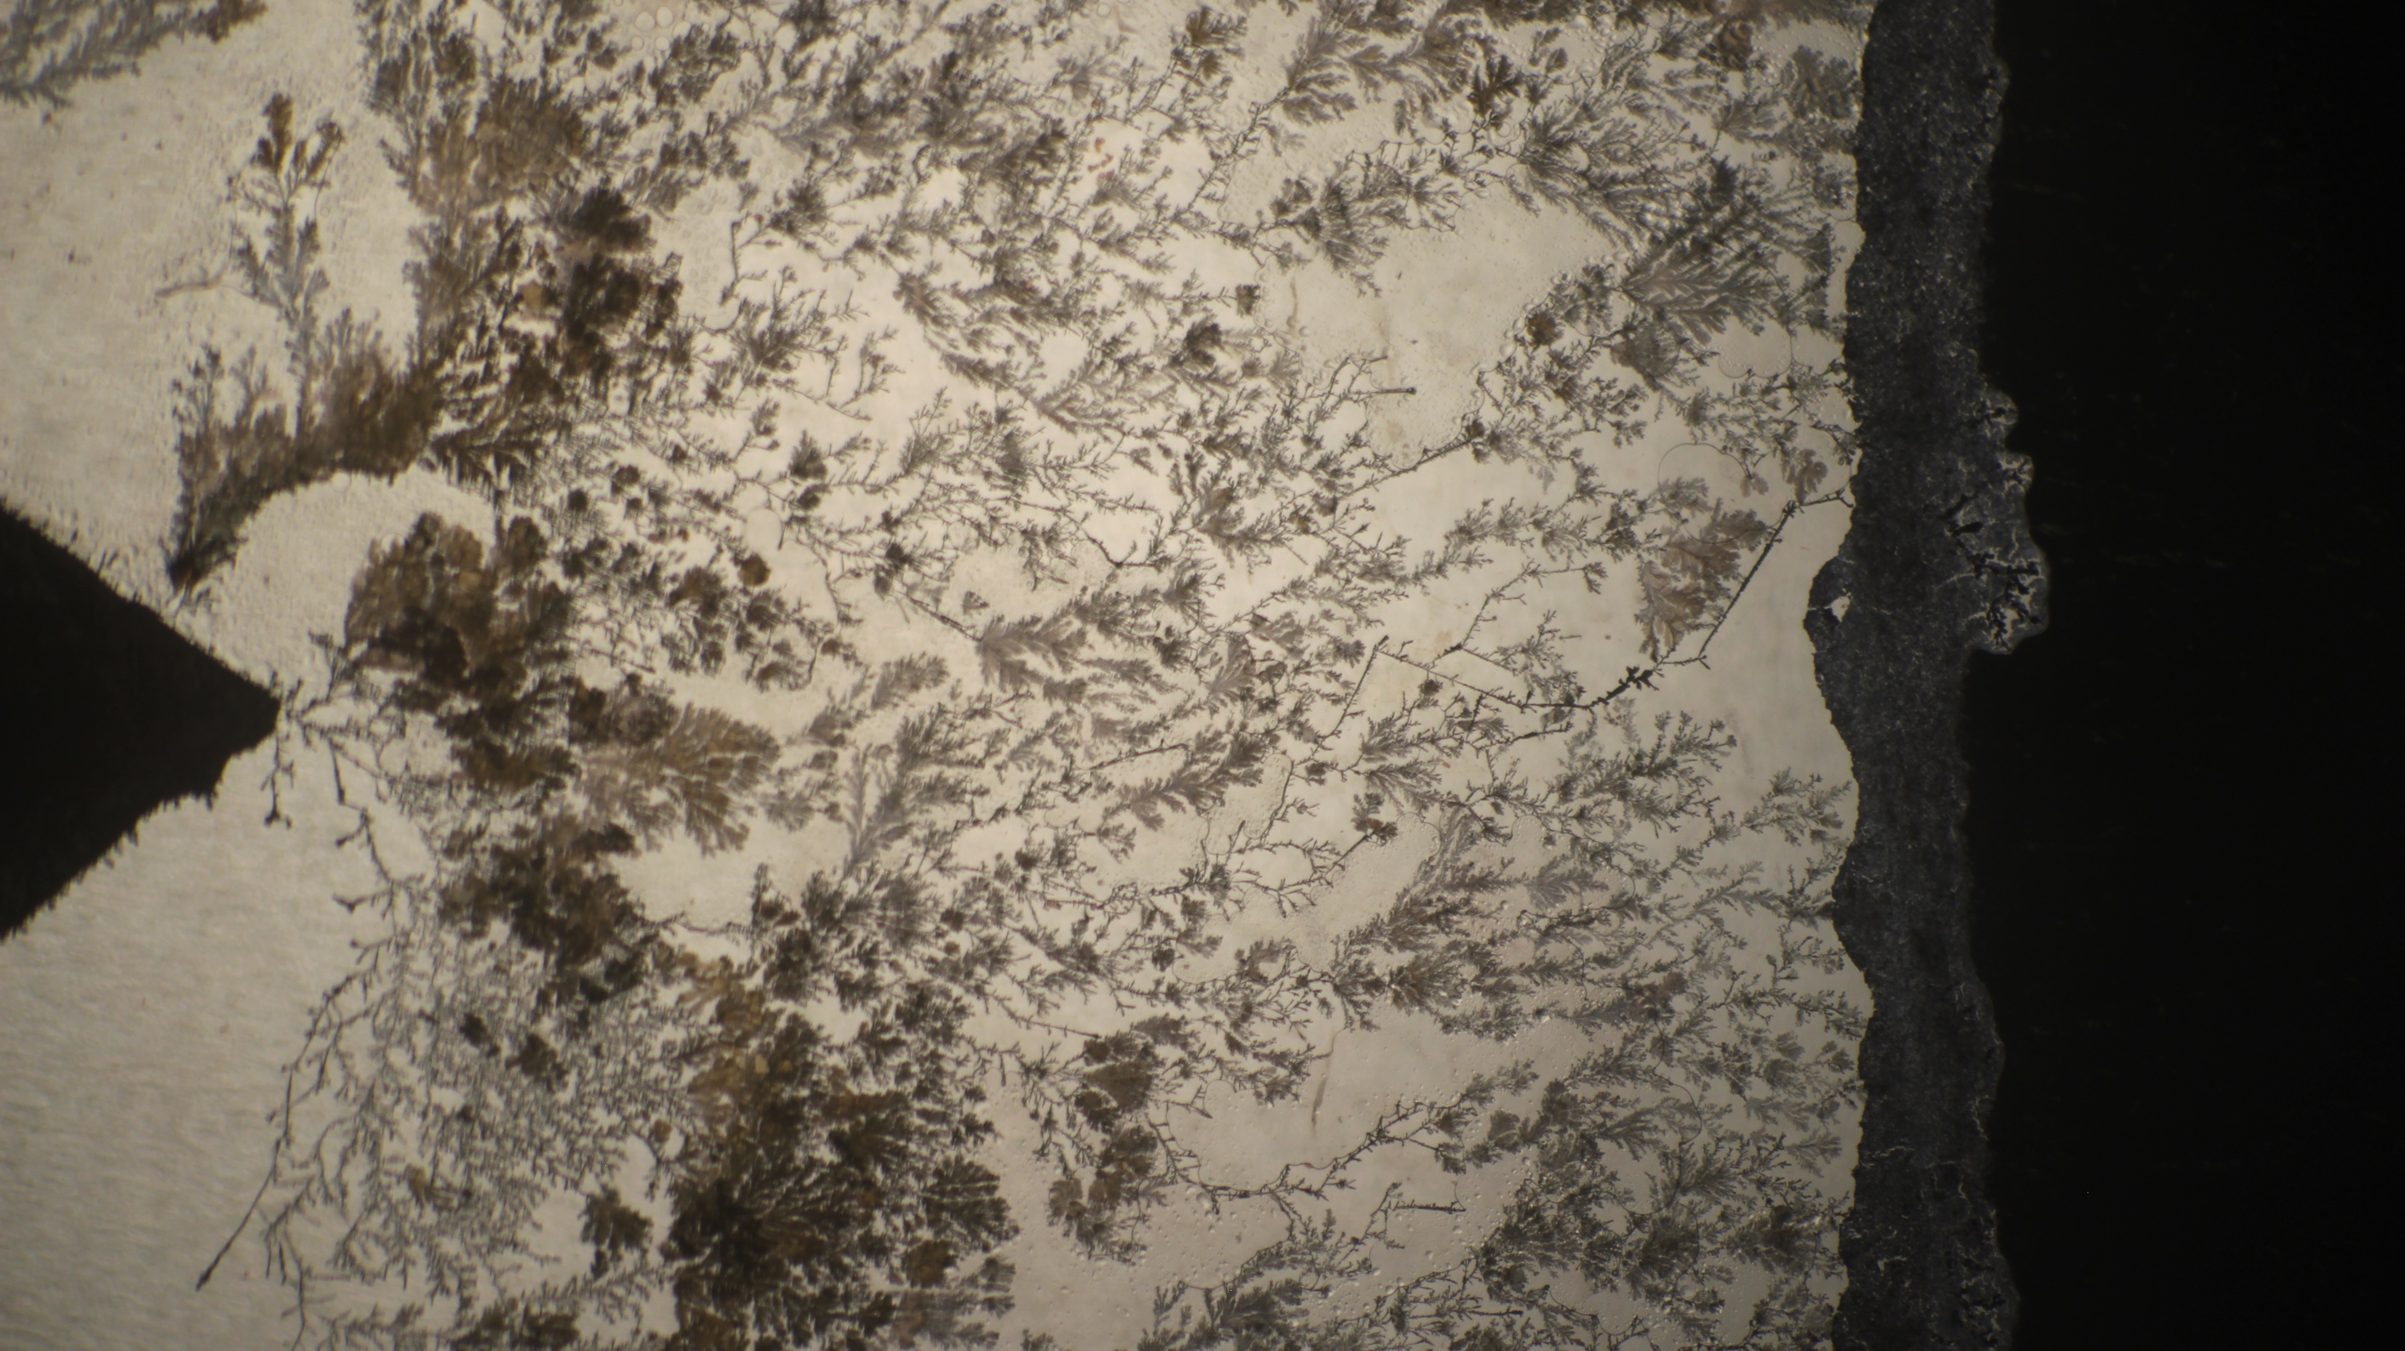

Slide 22



Slide 23
Abstract

Slide 24
Theoretical model

Slide 25





Experimental setup
$$\frac{∂C}{∂t}=−\left(u_{x}C_{x}^{′}+u_{y}C_{y}^{′}\right)+D\left(C_{xx}^{′′}+C_{yy}^{′′}\right)+μ(E_{x}C_{x}^{′}+E_{y}C_{y}^{′})$$
Deposit
$AgNO_{3}$ aq.
$$\frac{∂C}{∂t}=−\left(u⋅∇\right)C+D∆C+μ\left(E⋅∇\right)C$$
$Ag$ cathode
$$Ag^{+}$$
$Ag$ anode
Mass transport by:
Migration
Diffusion
Convection
Surface
reaction
$$ReMc=\frac{u_{0}a/ν}{μΦ_{0}/ν}=?$$
$$−$$
$$+$$
$a≈1 cm$ – typical size
$Φ_{0}≈2 V$ – typical potential
$μ=8⋅{10}^{−4} cm^{2}V^{−1}s^{−1}$ – migration coefficient
$u_{0}≈1⋅{10}^{−2}cm s^{−1}$ – typical growth rate

